Slide 1

Akella krishna Sowjanya bonam Venkata chalamayya college of engineering odalarevu, Andhra Pradesh Artificial intelligence and machine learning.
Employee Burnout Prediction

Slide 2
Problem Statement: Employee Burnout Prediction
Using Linear Regression, Predicting Employee Burnout.
Like never-ending storms, employee burnout drowns morale, productivity and the overall health of an organization. In other words, constant on-the-job stress eventually drains you emotionally (exhaustion), leaves you feeling detached and hostile--cynical about the reason for your job [profession], or life in general-an attitude that manifests as weakened professional efficacy. Our goal is to promote healthier waters for all by learning who impacts the workplace and which solutions make system-wide impact. Predictive model predictive scores Per-employee burnout risk score This provides an early indication of risk, enabling organizations to channel resources and assistance at those who are most likely in need. This will result in data-driven, point-in-time recommendations for intervention strategies or reductions to workloads as well as well-being efforts resulting an even more resilient and engaged workforce.

Slide 3
Project Agenda: Employee Burnout Prediction
The first step is setting project goals, deliverables, and success criteria then build a team to do it just as defining what we mean by AI engineering. We will then go on to create a comprehensive schedule with significant milestones. First we must compile the dataset and perform some exploratory data analysis (EDA) to understand its structure, contents and see if any patterns or anomalies emerge. I will cover treatment of missing values, outliers and inconsistencies even scale numerical features while changing categorical variables to be used as well engineering newer feature during Data Preprocessing stage. After splitting the data in a test-train split, we might pick appropriate ML algorithms for regression tasks like XGBoost, Decision Trees or Random forest and Linear Regression Evaluation: We use RMSE, MAE and R to access the performance of our model.

Slide 4
Project Overview: Employee Burnout Prediction
Predictive Modeling :
Objective: Develop and train machine learning models to predict the burnout rate for each employee.
Data Insights :
Objective: Analyze the data to uncover key factors contributing to employee burnout.
Actionable Recommendations :
Objective: Provide insights and recommendations for organizations to effectively mitigate employee burnout.
Project Steps :
Data Understanding and Exploration.
Data Preprocessing.
Model Development.
Model Evaluation and Insights.
Model Evaluation and Insights

Slide 5
THE END USERS of this project :
Employees
Management and Leadership
Human Resources (HR) Teams
Data Analysts and Researchers
Occupational Health and Safety (OHS) Officers

Slide 6
SOLUTION AND ITS VALUE PROPOSITION
The method entails creating a thorough predictive model to evaluate employee burnout depending on a number of variables, including job characteristics, mental health indicators, and demographics. This model will use cutting-edge machine learning techniques to analyze the dataset and identify important predictors of burnout. The following elements are part of the solution:
Proactive Burnout Management: Seek out and resolve possible burnout problems before they worsen.
Improved Well-Being of Employees: Encourage a more wholesome and encouraging work atmosphere.
Benefits for the Organization: Improve the culture and performance of the organization.
Data-Driven Decision Making: Make strategic decisions based on data insights.

Slide 7
Customization and Personalization of the Employee Burnout Prediction Project
Comprehensive Knowledge of Context
Advanced Methods for Processing Data
Choosing and Customizing a Model
Including Psychological Aspects
Framework for Continuous Improvement

Slide 8
ModeLling with Linear Regression
Getting Ready for Data
Data splitting: Separate the training and testing sets from the dataset.
Feature Scaling: Bringing numerical attributes into uniformity.
Convert categorical variables into a numerical format by encoding them.
Models of Training
Linear Regression Model: Utilizing the training dataset, train the linear regression model.
Evaluation of the Model
Performance Metrics: To evaluate the model's performance, use metrics such as RMSE, MAE, and R2 score.
Model Modification
Feature Selection: To improve model performance, assess and choose the most crucial features.

Slide 9
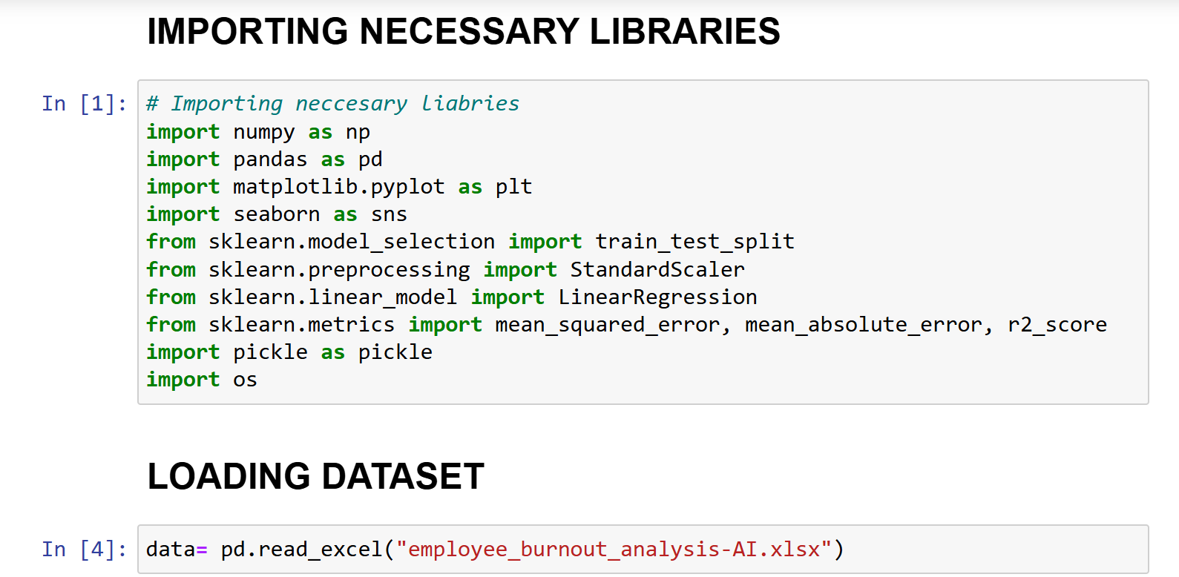
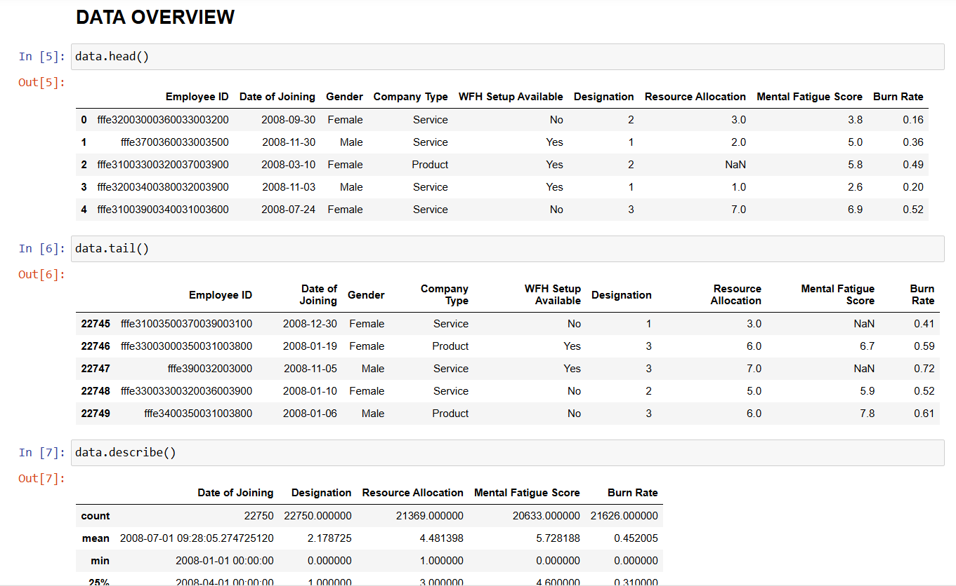
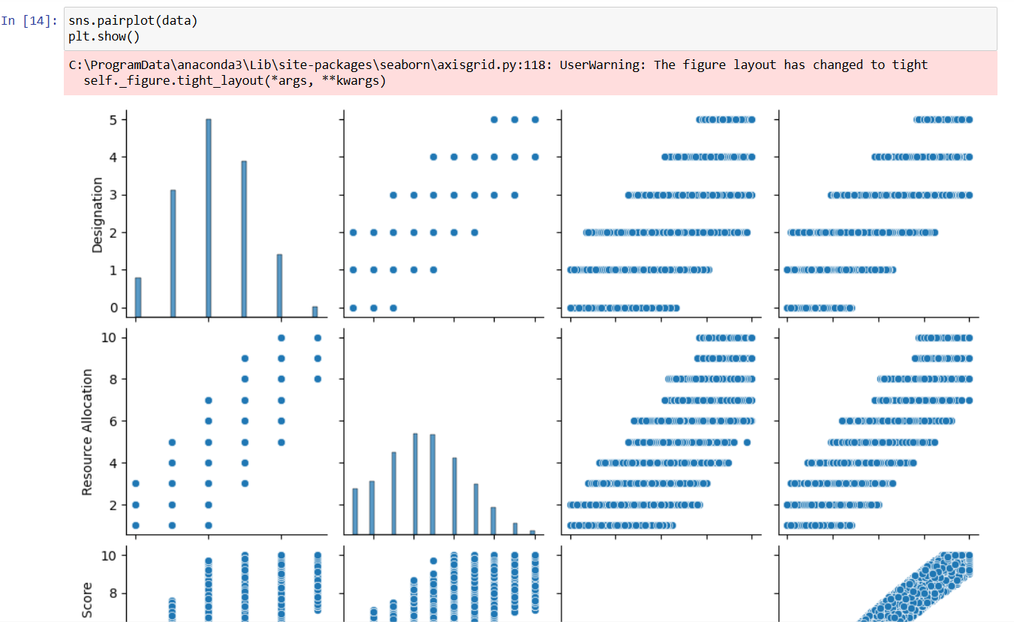
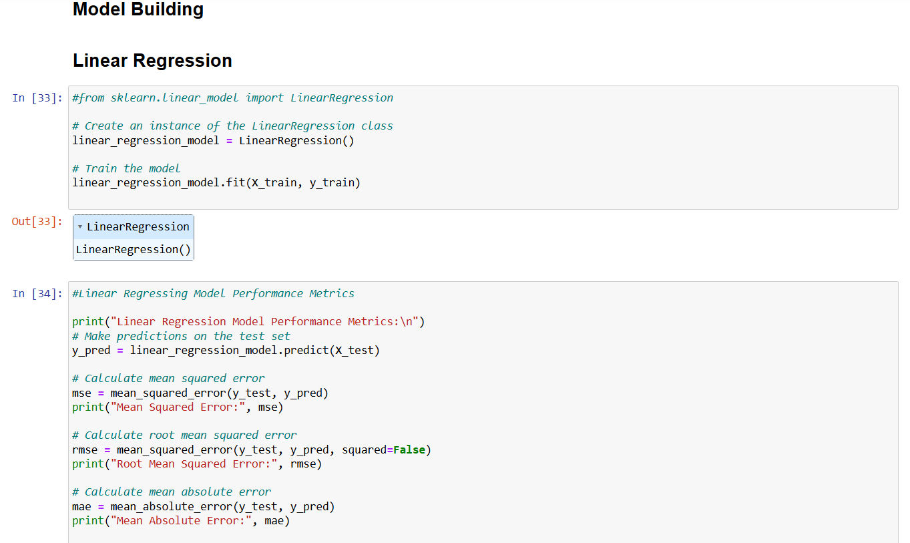
Results

Slide 10
links
Dataset Link :https://www.kaggle.com/datasets/blurredmachine/are-your-employees-burning-out
E-mail : krishnasowjanyaakella@gmail.com

